Slide 1

Recommender Systems with Python
Chapter 6^{ο} :
Machine Learning with Neural Networks

Slide 2
Description of Chapter 6
Single Layer Perceptron
Multi-Layer Perceptron
Graph Convolutional Networks
Other neural networks

Slide 3
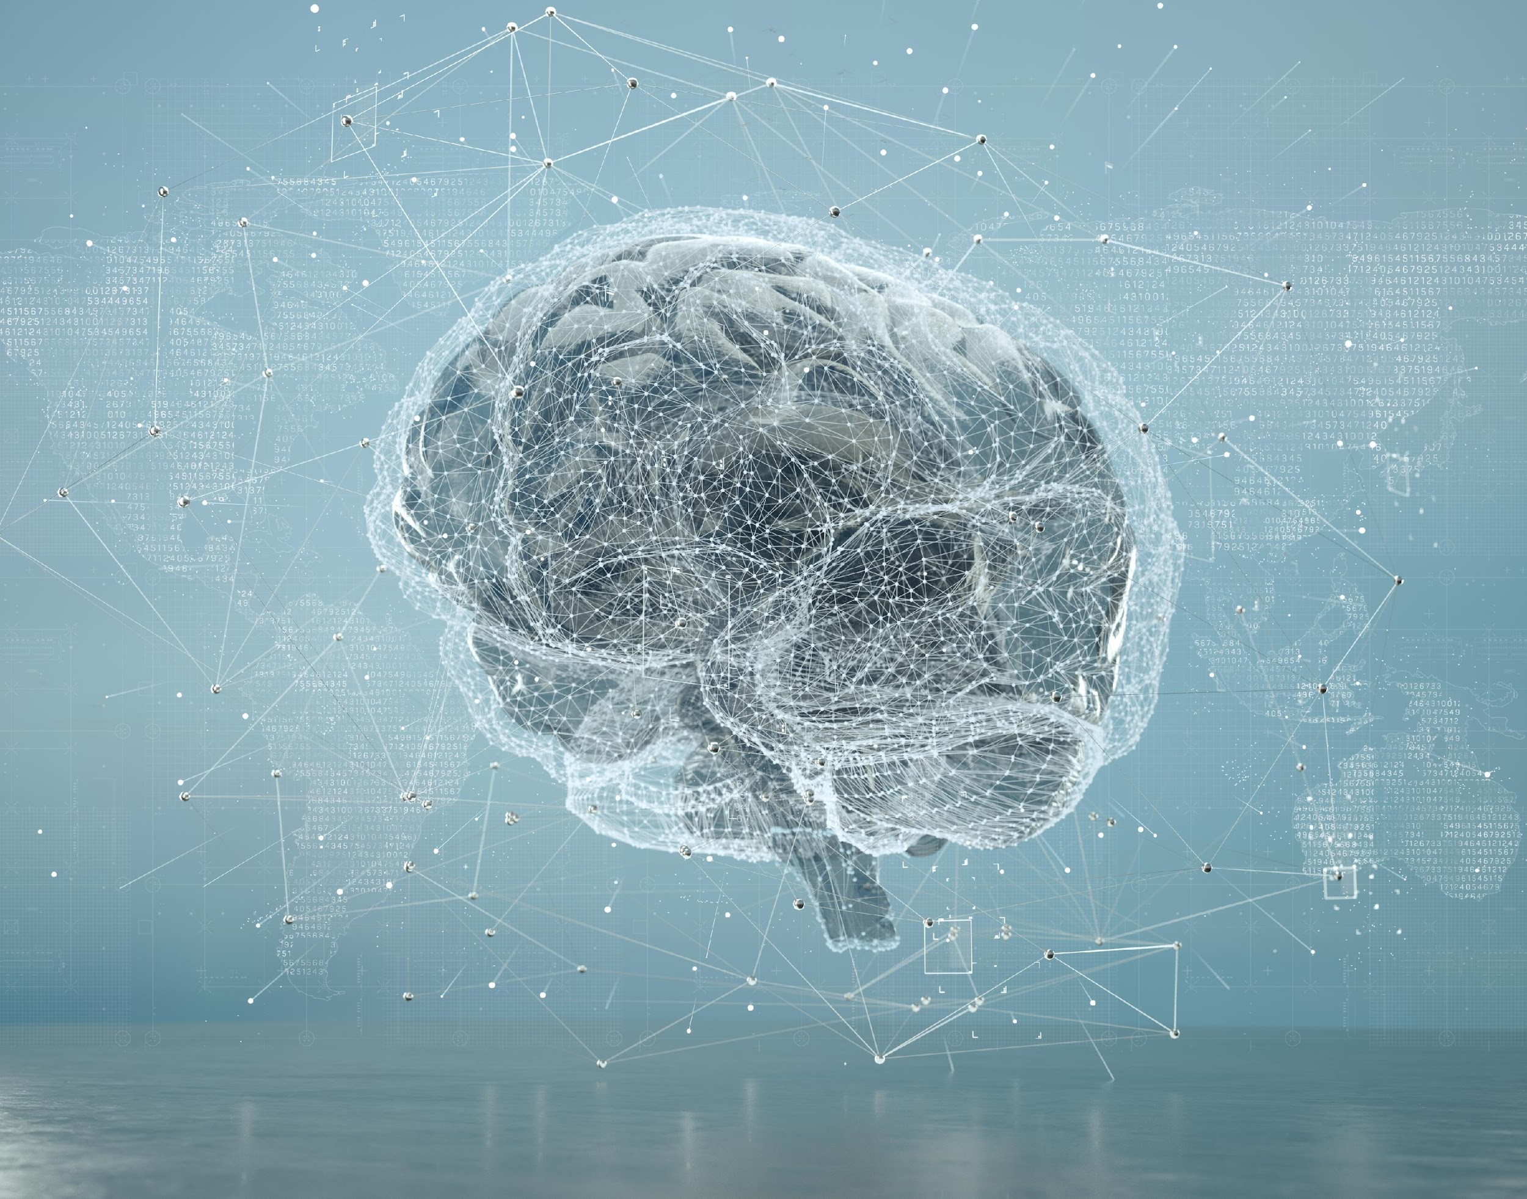
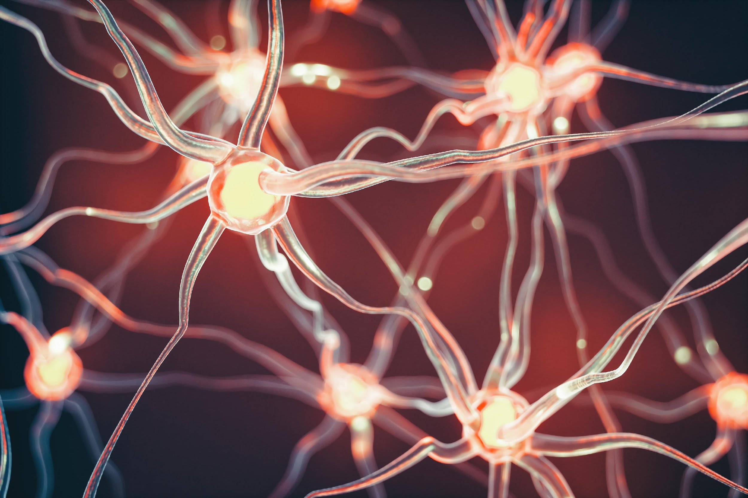
Neurons and Synapses in Biological Systems
In human brain, a neural synapse is a connection that allows a neuron (nerve cell), to transmit an electrical or chemical signal to another neuron, causing some change in the state of the latter
In biological systems, learning takes place through an increase in the strength (eg thickness) of synapses, as a result of their strengthening by the repetition of the same external stimuli.

Slide 4
Neurons and Synapses in Artificial Systems
Artificial neural networks simulate the human brain by using neurons (or nodes), which are connected to each other through connections called synapses.
The most basic computational structure in artificial neural networks is the perceptron, which contains a set of input nodes and an output node
Architecture of Single-Layer Perceptron
X1
W₁
Χ2
W₂
∑
f(z)
Z₁ = f(z)
W₃
X3
W₄
X4

Slide 5
Input Vector
Input values are represented as input vector
Each element of the vector feeds an input neuron
Input Nodes
X1
W₁
Χ2
W₂
∑
f(z)
Z₁ = f(z)
X
W₃
X3
W₄
X4
Input vector
x = [x₁, x₂, ..., x_{n}], x_{i} ∈ R

Slide 6
Weights’ vector
The weights located on the directed edges connecting a neuron of one layer to the neuron of the next layer are grouped into a weights' vector.
X1
W₁
Χ2
W₂
∑
f(z)
Z₁ = f(z)
W₃
X3
W₄
W
X4
Weights’ vector
w = [w₁, w₂, ..., w_{n}]^{T} , w_{i} ∈ R

Slide 7
Bias neuron
Bias neuron is an additional input to the input layer with fixed value equal to 1
The fixed value (1) guarantees the activation of neuron in case of zero inputs.
The bias node also ensures that the output of the neuron will not always be the same (deterministic).
X1
W₁
Χ2
W₂
∑
f(z)
Z₁ = f(z)
W₃
X3
W₄
X4
b
bias

Slide 8

Weighted Sum
The first calculation performed by the perceptron neuron is called Weighted Sum
It is modeled as the dot product between the weights vector and the input vector
Each input X is multiplied by the weight W of the corresponding directed edge
Finally, the products are summed and the value of the bias node is added
Weights’ Input
X1
W
W₁
Χ2
W₂
∑
f(z)
Z₁ = f(z)
X
W₃
X3
W₄
X4
Weighted Sum
b
z = x * w^{T}+ b
input vector

Slide 9

Activation Function f
The second calculation that the neuron performs is called activation function.
It uses as input the output of the weighted sum
Activation functions are divided into linear and non-linear
Choosing an appropriate activation function f is a critical part of neural network design because it leads to faster and more efficient prediction.
X1
W₁
Χ2
W₂
∑
f(z)
Z₁ = f(z)
W₃
X3
W₄
X4
Activation Function f
b

Slide 10
ACTIVATION FUNCTION

Slide 11
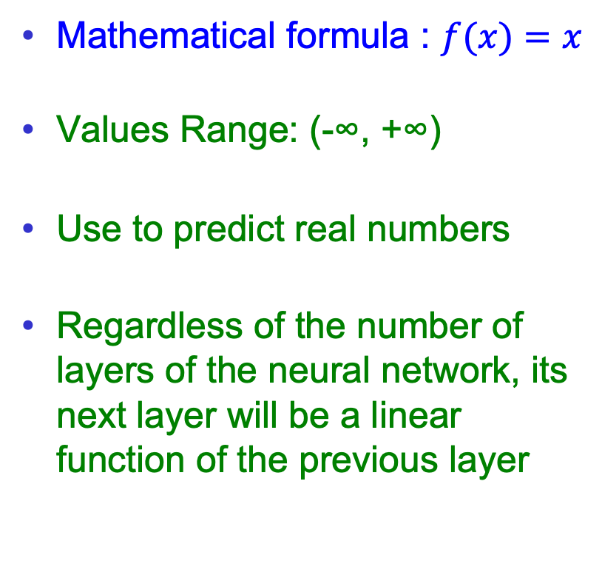
Types of Activation Functions
Mathematical formula : $f(x)=x$
Values Range: (-∞, +∞)
Use to predict real numbers
Regardless of the number of layers of the neural network, its next layer will be a linear function of the previous layer
Identity or Linear
∑

Slide 12
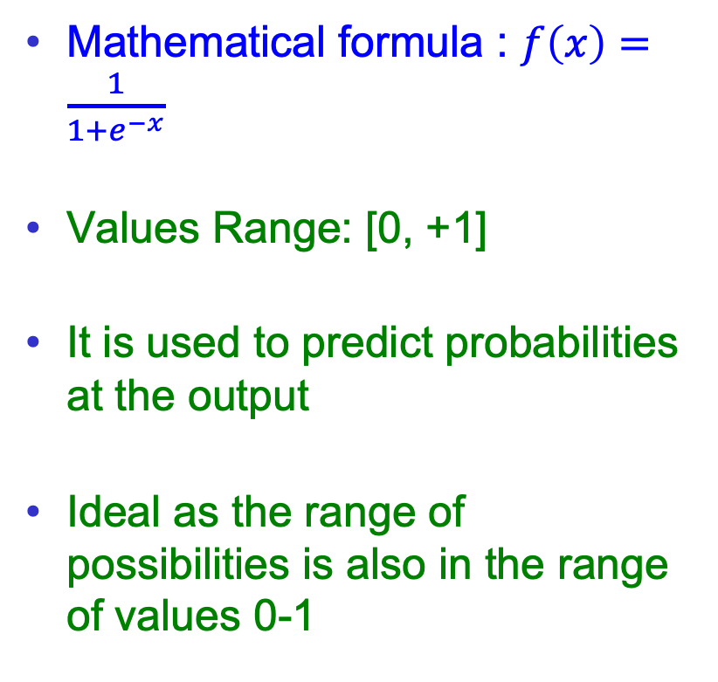
Types of Activation Functions
Mathematical formula : $f\left(x\right)=\frac{1}{1+e^{−x}}$
Values Range: [0, +1]
It is used to predict probabilities at the output
Ideal as the range of possibilities is also in the range of values 0-1
Sigmoid
∑
1
0.5

Slide 13
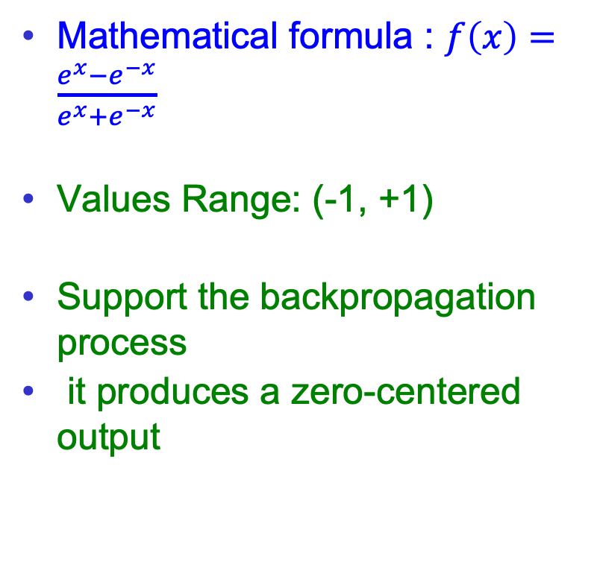
Types of Activation Functions
Mathematical formula : $f\left(x\right)=\frac{e^{x}−e^{−x}}{e^{x}+e^{−x}}$
Values Range: (-1, +1)
Support the backpropagation process
it produces a zero-centered output
hyperbolic tangent
∑
1
-1

Slide 14
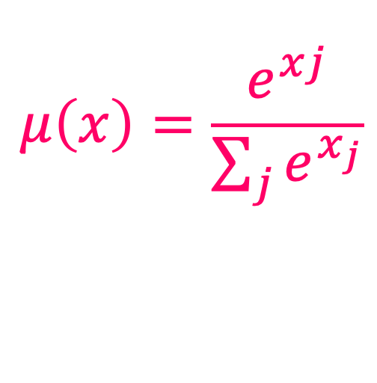
Types of Activation Functions
Softmax:
Given a vector x = [x_{1,}x₂,...,x_{n}] the softmax is calculated as follows:
μ(x) = [μ(x₁),μ(x₂),...,μ(x_{n})]
with:
According to softmax, the sum of the perceptron's outputs equals unity, and therefore its outputs can be interpreted as a probability.
$$μ\left(x\right)=\frac{e^{xj}}{\sum_{j}{e^{x_{j}}}}$$

Slide 15
LOSS FUNCTION

Slide 16
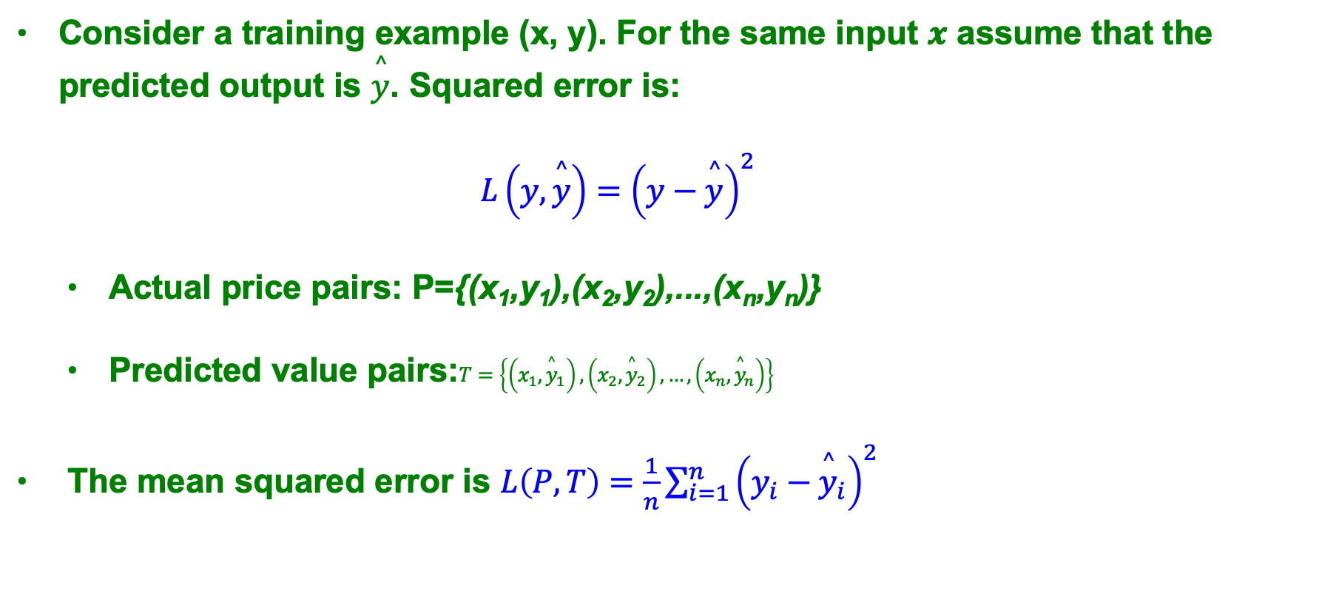
Regression Loss Function
Consider a training example (x, y). For the same input 𝒙 assume that the predicted output is $\overset{^}{y}$. Squared error is:
$$L\left(y,\overset{^}{y}\right)={\left(y−\overset{^}{y}\right)}^{2}$$
Actual price pairs: P={(x₁,y₁),(x₂,y₂),...,(x_{n},y_{n})}
Predicted value pairs:$T=\left\{\left(x_{1},{\overset{^}{y}}_{1}\right),\left(x_{2},{\overset{^}{y}}_{2}\right),…,\left(x_{n},{\overset{^}{y}}_{n}\right)\right\}$
The mean squared error is $L\left(P,T\right)=\frac{1}{n}\sum_{i=1}^{n}{{\left(y_{i}−{\overset{^}{y}}_{i}\right)}^{2}}$

Slide 17

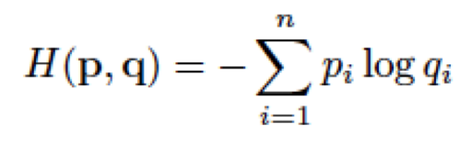
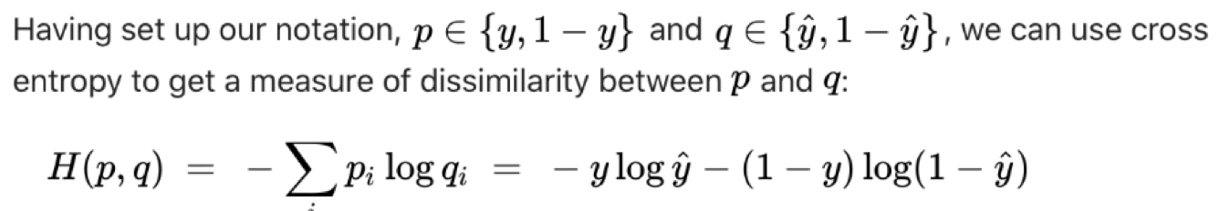
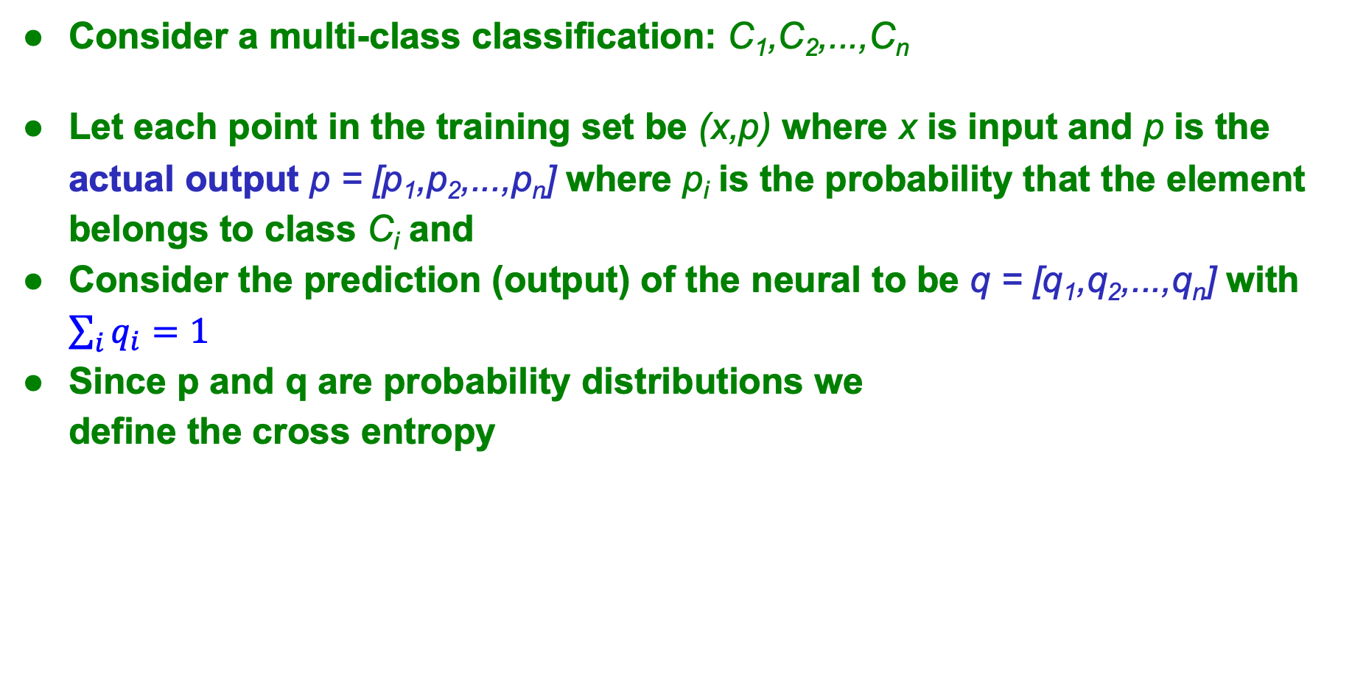
Classification Loss Function
Consider a multi-class classification: C₁,C₂,...,C_{n}
Let each point in the training set be (x,p) where x is input and p is the actual output p = [p₁,p₂,...,p_{n}] where p_{i} is the probability that the element belongs to class C_{i} and
Consider the prediction (output) of the neural to be q = [q₁,q₂,...,q_{n}] with $\sum_{i}{q_{i}=1}$
Since p and q are probability distributions we
define the cross entropy

Slide 18
Steps of training a neural network
Initialization: Assigning random values to the network weights
Calculation of the activation functions of the network, i.e. its output, for each of the training samples (Feedforward computations)
Calculate the error (error of loss function) for the set of training data. The worse the prediction, the bigger the error.
Back propagation of error through the network to determine the new values for the network weights.
Repeat steps 2-5 until the error is reduced to an acceptable level

Slide 19

Single-Layer Perceptron for Item-based Collaborative Filtering
Predict whether U₄ will like or not the element I4
 | I₁ | I₂ | I₃ | I₄
U₁ | 4 | 1 | 1 | 4
U₂ | 1 | 4 | 2 | 0
U₃ | 2 | 1 | 4 | 5
U₄ | 1 | 4 | 1 | ?
I₁
W₁
I₂
X
W₂
∑
I₄
I₃
W₃

Slide 20
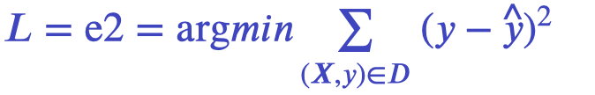


Single-Layer Perceptron for Item-based Collaborative Filtering
We define an objective function (loss function) of minimization of the difference between actual and predicted item scores
where y: the actual score of an item
: the predicted score of an item
(X,y): training data pair
I₁
W₁
I₂
Loss Function = (y – ( X * W^{T} ))²
X
W₂
∑
I₃
W₃
I₄

Slide 21


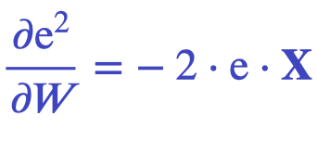
Gradient Descent
It minimizes the loss function by adjusting the vector of weights W accordingly.
The predicted scores of the neural network are used to generate an approximate score table
Finds the direction in which the weight vector W should be changed to reduce the difference between actual and predicted scores
Computes the partial derivative of the error function e² to the vector of weights.
where e is error

Slide 22
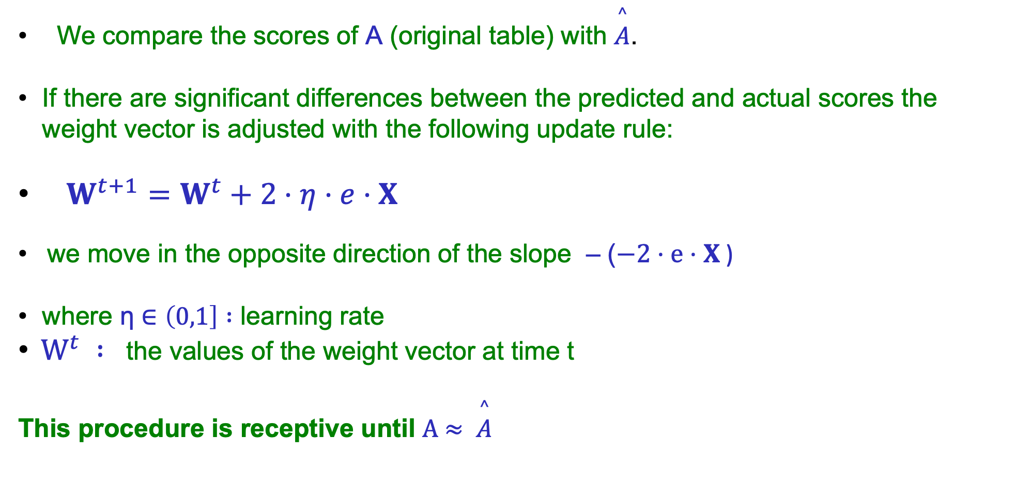
Back Propagation
We compare the scores of Α (original table) with $\overset{^}{A}$.
If there are significant differences between the predicted and actual scores the weight vector is adjusted with the following update rule:
$W^{t+1}=W^{t}+2⋅η⋅e⋅X$
we move in the opposite direction of the slope – ($−2⋅e⋅X$ )
where η $∈\left(0,1\right] :$ learning rate
$W^{t} :$ the values of the weight vector at time t
This procedure is receptive until Α$≈ \overset{^}{A}$
Notes:
Οι προβλεπόμενες βαθμολογές του νευρωνικού δικτύου χρησιμοποιούνται για την δημιουργία ενός προσεγγιστικού πίνακα βαθμολογιών
. =X *

Slide 23
Disadvantages of Single-layer perceptron
The main disadvantage of the perceptron is that it cannot split non-linearly separable data since it only consists of the layer of input nodes and a single output node.

Slide 24
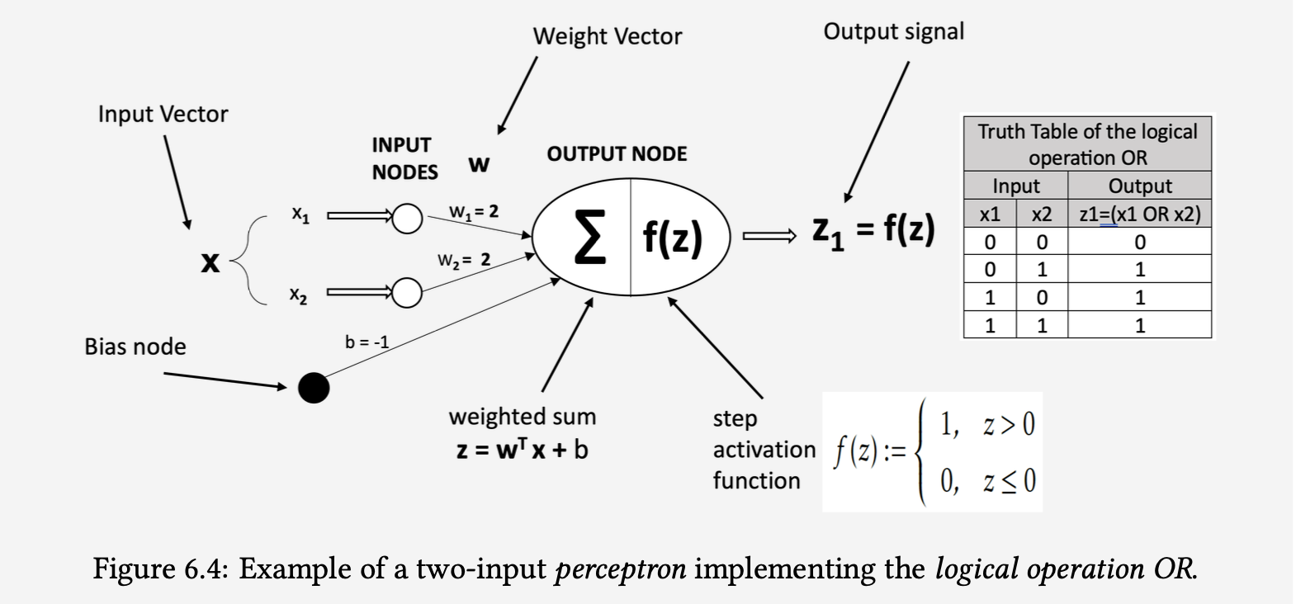
Example: Implementing the OR Logical Operation using a perceptron
Notes:
Έστω ότι έχουμε έναν πίνακα με τις βαθμολογίες για 4 ταινίες από 4 χρήστες και θέλουμε να προβλέψουμε εάν η 4^{η} ταινία θα αρέσει στον 4^{ο} χρήστη ή όχι

Slide 25
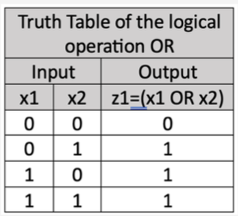

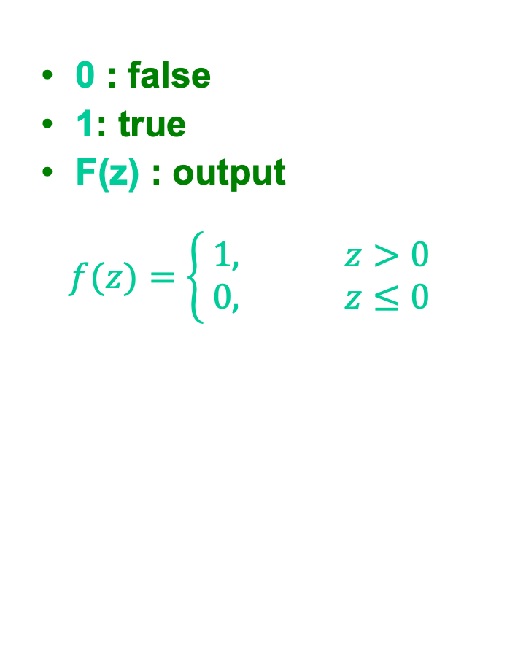
Two-Input Single Layer Perceptron with Step Function
0 : false
1: true
F(z) : output
$$f(z)=\left\{\begin{aligned} 1, z>0 \\ 0, z≤0\end{aligned}\right.$$
0
X1
W₁ = 2
∑
f(z)
Z₁ = f(z)
1
W₂ = 2
Χ2
-1
b

Slide 26
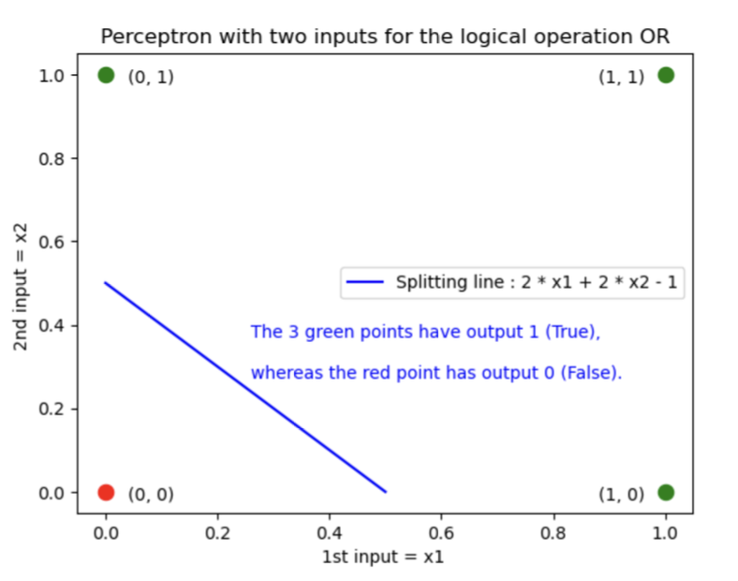
Geometric representation of the inputs and outputs of the OR Logic Operation
Notes:
Έστω ότι έχουμε έναν πίνακα με τις βαθμολογίες για 4 ταινίες από 4 χρήστες και θέλουμε να προβλέψουμε εάν η 4^{η} ταινία θα αρέσει στον 4^{ο} χρήστη ή όχι

Slide 27
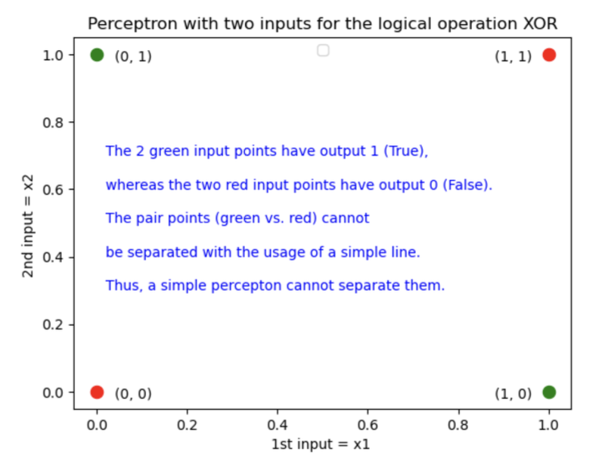
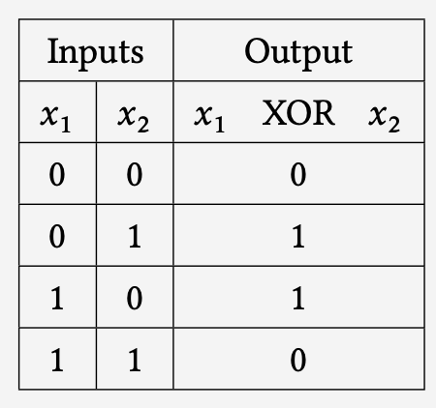
Geometric representation of the inputs and outputs of the ΧOR Logic Operation
Notes:
Έστω ότι έχουμε έναν πίνακα με τις βαθμολογίες για 4 ταινίες από 4 χρήστες και θέλουμε να προβλέψουμε εάν η 4^{η} ταινία θα αρέσει στον 4^{ο} χρήστη ή όχι

Slide 28
Multi – Layer Perceptrons
Neurons are arranged in layers, of which the input and output layers are separated by another group of additional intermediate layers. These layers are called hidden.
This particular architecture MLP is referred as feed forward neural network.
Input Layer
Hidden Layer
Output Layer
Users
Elements
W1
W₂
U₁
Ι₁
U₂
Κ₁
I2
X
Y
U₃
Κ₂
I₃
U₄
I₄
W : weights synapse between layers

Slide 29
Multi – Layer Perceptrons
Usually each node of a layer is connected to all the nodes of the next layer (fully dense network).
They provide the ability to calculate complex non-linear correlations between data
To the neurons of each different layer of such a neural network, we can also apply a different activation function
Input Layer
Hidden Layer
Output Layer
Users
Elements
W1
W₂
U₁
Ι₁
U₂
Κ₁
I2
Y
U₃
Κ₂
I₃
U₄
I₄
W : weights synapse between layers
Notes:
Με αυτόν τον τρόπο μπορούμε να υπολογίσουμε πολύπλοκες και μη γραμμικές συναρτήσεις, αφού στους νευρώνες κάθε στρώματος μπορούμε να εφαρμόσουμε διαφορετικές συναρτήσεις ενεργοποίησης

Slide 30
Multi-Layer Perceptron for Matrix Factorization
 | I₁ | I₂ | I₃ | I₄
U₁ | 4 | 1 | 1 | 4
U₂ | 1 | 4 | 2 | 0
U₃ | 2 | 1 | 4 | 5
U₄ | 1 | 4 | 1 | ?
Predict if U₄ will like or not element I₄

Slide 31
Example: Multi–layer Perceptron
ONE-HOT ENCODED INPUT FOR USER U₄
INPUT LAYER
HIDDEN LAYER
OUTPUT LAYER
Users
Elements
T
U4 X 2
V_{2 X 4}
0
U₁
Ι₁
0
U₂
Κ₁
I₂
Y
X
0
U₃
Κ₂
I₃
1
U₄
I₄
Notes:
Πιο αναλυτικά, στην είσοδο του ΝΔ δίνεται ένα διάνυσμα τόσων διαστάσεων όσο και κόμβων εισόδου. Οι τιμές του είναι όλες μηδενικές, εκτός από αυτή για το κόμβο του χρήστη που μας ενδιαφέρει.

Slide 32

Example of a Multi-layer Perceptron
Input Layer
Hidden Layer
Output Layer
Users
Elements
T
U4 X 2
V_{2 X 4}
0
U₁
Ι₁
W₁₁
W₁₁
W₂₁
0
W₁₂
U₂
W₂₁
Κ₁
W₁₂
I₂
W₂₂
W₂₂
Y
X
0
W₃₁
U₃
W₃₂
W₁₃
I₃
Κ₂
W₂₃
W₄₁
1
W₄₂
W₁₄
U₄
W₂₄
I₄
$$Z_{l}=f\left(W_{l}^{T}⋅Z_{l−1}+b_{l}\right)$$
Notes:
Στα κρυφά στρώματα, παίρνουμε ως είσοδο το διάνυσμα του προηγούμενου στρώματος και το πολλαπλασιάζουμε με τα βάρη του στρώματος που μελετάμε. Εάν θέλουμε, προσθέτουμε και κάποιο bias.

Slide 33
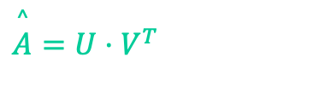
Example of a Multi–layer Perceptron
$$\overset{^}{A}=U⋅V^{T}$$
Predicted user ratings
Input Layer
Hidden Layer
Output Layer
Users
Elements
T
U4 X 2
V_{2 X 4}
0
U₁
Ι₁
W₁₁
W₁₁
W₂₁
0
W₁₂
U₂
W₂₁
Κ₁
W₁₂
I₂
W₂₂
W₂₂
Y
X
0
W₃₁
U₃
W₃₂
W₁₃
I₃
Κ₂
W₂₃
W₄₁
1
W₄₂
W₁₄
U₄
W₂₄
I₄
Notes:
Οπότε τελικά στο ΝΔ αυτό τελική έξοδος θα ήταν ένας πίνακας προβλέψεων A ̂.

Slide 34
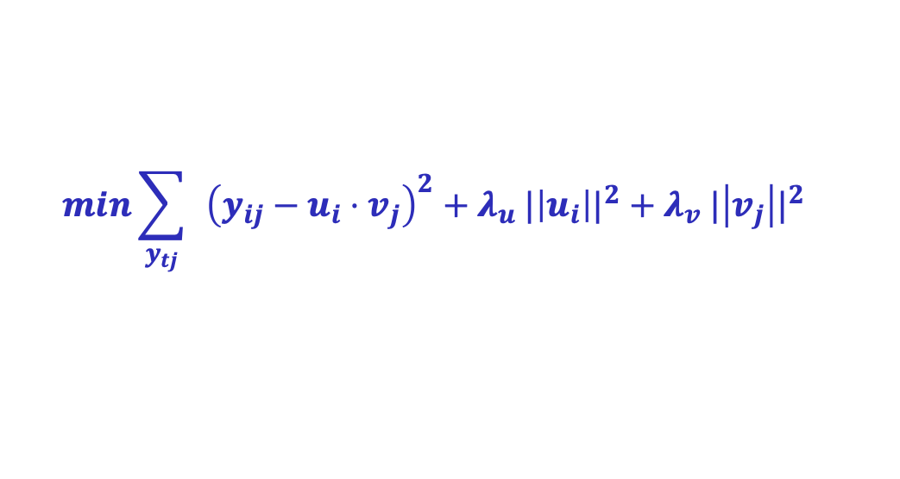
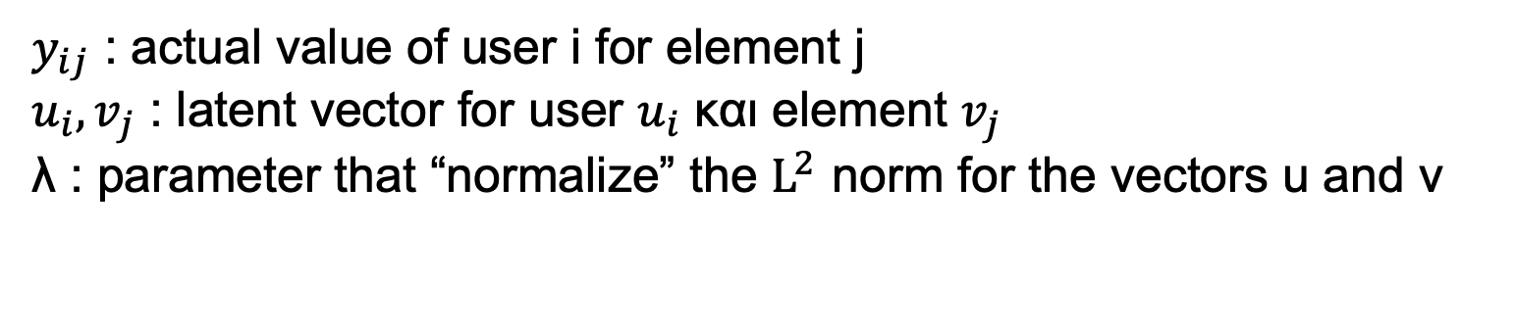
Input Layer
Hidden Layer
Output Layer
Users
Elements
T
U4 X 2
V_{2 X 4}
0
U₁
Ι₁
W₁₁
W₁₁
W₂₁
0
W₁₂
U₂
W₂₁
Κ₁
W₁₂
I₂
W₂₂
W₂₂
Y
X
0
W₃₁
U₃
W₃₂
W₁₃
I₃
Κ₂
W₂₃
W₄₁
1
W₄₂
W₁₄
U₄
W₂₄
I₄
$$min\sum_{y_{tj}}{ }{\left(y_{ij}−u_{i}⋅v_{j}\right)}^{2}+{λ_{u} |\left|u_{i}\right||}^{2}+{λ_{v} |\left|v_{j}\right||}^{2}$$
$y_{ij}$ : actual value of user i for element j
$u_{i},v_{j}$ : latent vector for user $u_{i}$ και element $v_{j}$
λ : parameter that “normalize” the $L^{2 }$norm for the vectors u and v
Notes:
Αυτό που επιθυμούμε και επιδιώκουμε, είναι να ελαχιστοποιήσουμε τη διαφορά μεταξύ του πίνακα προβλέψεων σε σχέση με τις πραγματικές τιμές των χρηστών. Αυτό το πετυχαίνουμε βρίσκοντας το ελάχιστο άθροισμα της τετραγωνισμένης διαφοράς των διανυσμάτων με τις προβλεπόμενες τιμές από τις πραγματικές συν μια κανονικοποίηση της L² νόρμας των u και v

Slide 35
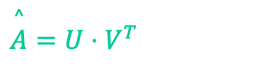
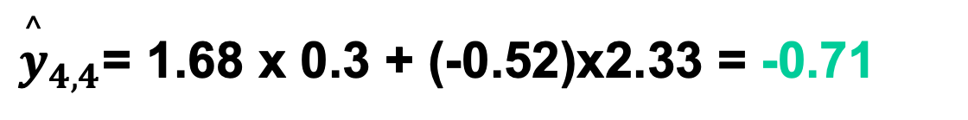
Example of a Multi–layer Perceptron
$$\overset{^}{A}=U⋅V^{T}$$
Predicted ratings of users
Input Layer
Hidden Layer
Input Layer
Users
T
Element
U4 X 2
V_{2 X 4}
0
1
U₁
Ι₁
W₁₁ = 0.67
W₁₁ = 0.82
0
W₁₂ = 1.67
W₂₁ = 1.21
4
U₂
W₂₁ = 1.77
Κ₁
W₁₂ = 2.2
I₂
X
W₂₂ = 0.22
W₂₂ = -0.39
Y
0
W₃₁ = 0.86
W₁₃ = 1.08
1
U₃
W₃₂ = 1.97
Κ₂
I₃
W₂₃ = 0.97
W₄₁ = 1.68
W₄₂ = - 0.52
W₁₄ = 0.3
1
W₂₄ = 2.33
?
U₄
I₄
${\overset{^}{y}}_{4,4}$= 1.68 x 0.3 + (-0.52)x2.33 = -0.71
Notes:
Έχοντας εκπαιδεύσει κατάλληλα το μοντέλο μας έχουμε ορίσει τα βάρη στις συνάψεις μεταξύ των νευρώνων και πάμε να δούμε πώς θα προβλέψουμε τις αξιολογήσεις του χρήστη 4

Slide 36

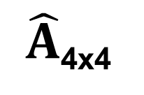
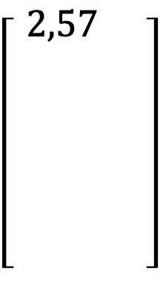
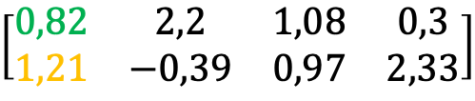
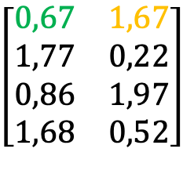
UV-decomposition
U4 X 2
T
V_{2 X 4}
$$\left[\begin{matrix}\begin{aligned}0,67 \\ 1,77 \\ 0,86\end{aligned} & \begin{aligned}1,67 \\ 0,22 \\ 1,97\end{aligned} \\ 1,68 & 0,52\end{matrix}\right]$$
$$\left[\begin{aligned} \begin{matrix}\begin{aligned} \begin{aligned}2,57 \\ \\ \\ \\ \\ \end{aligned}\end{aligned} & \\ & \end{matrix}\end{aligned}\right]$$
X
$$\left[\begin{matrix}0,82 & 2,2 & 1,08 & 0,3 \\ 1,21 & −0,39 & 0,97 & 2,33\end{matrix}\right]$$
=

Slide 37
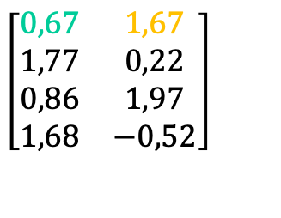
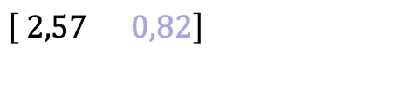

UV-decomposition
U4 X 2
T
V_{2 X 4}
$$\left[\begin{matrix}0,67 & 1,67 \\ 1,77 & 0,22 \\ 0,86 & 1,97 \\ 1,68 & −0,52\end{matrix}\right]$$
X
$$\left[\begin{matrix}0,82 & 2,2 & 1,08 & 0,3 \\ 1,21 & −0,39 & 0,97 & 2,33\end{matrix}\right]=$$
=
$$\left[\begin{aligned} 2,57 0,82\end{aligned}\right]$$

Slide 38
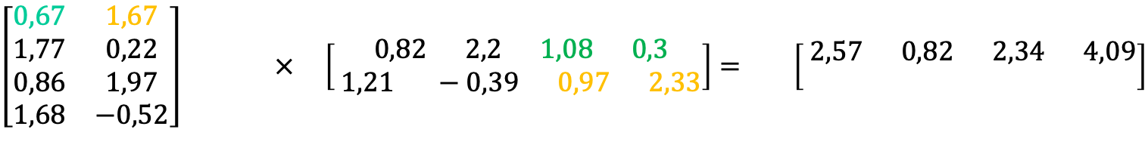
UV-decomposition
U4 X 2
T
V_{2 X 4}
$$\left[\begin{matrix}0,67 & 1,67 \\ 1,77 & 0,22 \\ 0,86 & 1,97 \\ 1,68 & −0,52\end{matrix}\right] × \left[\begin{aligned} 0,82 2,2 1,08 0,3 \\ 1,21 −0,39 0,97 2,33\end{aligned}\right]= \left[\begin{aligned} 2,57 0,82 2,34 4,09 \\ \end{aligned}\right]$$

Slide 39
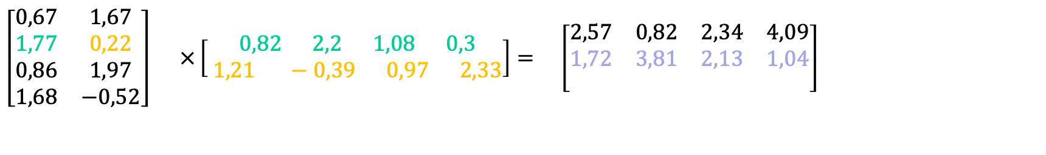
UV-decomposition
U4 X 2
T
V_{2 X 4}
$$\left[\begin{matrix}0,67 & 1,67 \\ 1,77 & 0,22 \\ 0,86 & 1,97 \\ 1,68 & −0,52\end{matrix}\right] ×\left[\begin{aligned} 0,82 2,2 1,08 0,3 \\ 1,21 −0,39 0,97 2,33\end{aligned}\right]= \left[\begin{matrix}2,57 & 0,82 & 2,34 & 4,09 \\ 1,72 & 3,81 & 2,13 & 1,04 \\ & & & \end{matrix}\right]$$

Slide 40


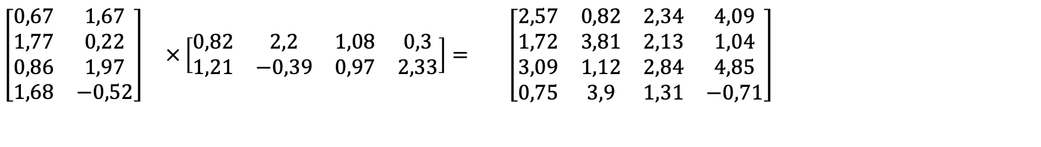
UV-decomposition
T
U4 X 2
V_{2 X 4}
$$\left[\begin{matrix}0,67 & 1,67 \\ 1,77 & 0,22 \\ 0,86 & 1,97 \\ 1,68 & −0,52\end{matrix}\right] ×\left[\begin{matrix}0,82 & 2,2 & 1,08 & 0,3 \\ 1,21 & −0,39 & 0,97 & 2,33\end{matrix}\right]= \left[\begin{matrix}2,57 & 0,82 & 2,34 & 4,09 \\ 1,72 & 3,81 & 2,13 & 1,04 \\ 3,09 & 1,12 & 2,84 & 4,85 \\ 0,75 & 3,9 & 1,31 & −0,71\end{matrix}\right]$$
${\overset{^}{y}}_{4,4}$= 1.68 x 0.3 + (-0.52)x2.33 = -0.71

Slide 41
Convolution Neural Networks (CNNs)
A Convolutional Neural Network (CNN) is essentially a multi-layer Perceptron.
Connectivity mode between CNN neurons similar to the visual cortex of organisms
Area of cells sensitive to specific areas of the visual field.
A predefined region of the previous layer of neurons is merged and then promoted to the next layer.
Extract local image features.
Maintaining the approximate position of a feature relative to other features.

Slide 42
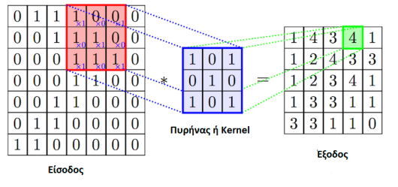
Convolution Neural Network (CNN) architecture
Convolve layer:
Apply filters to specific features or patterns in the original input image.
Creation of Multiple 2D feature maps
Subsampling or pooling layer:
Reduce feature map resolution.
Input : big picture
Output : smaller dimensional images.
Kernel
Output
Input

Slide 43
Applications of Convolution Neural Network (CNN)
Areas of data processing and analysis:
Image Processing
Natural Language Processing
Graph Data Analytics
Effective and correct predictions (eg image and face recognition, voice and speech recognition, etc.).

Slide 44
Structural components of a Graph Convolution Network (GCN)
Use of adjacency matrix for recording the connections (links) of the nodes of the graph
Use of vectors that express the node features of the graph
Co-evolution techniques of the links and features of the graph nodes are applied.

Slide 45
Example (1/9):
Scenario: Let's say we run an online publishing house that offers personalized content to its readers based on their research preferences and collaborations with other readers.
The creation of a Recommendation System is requested which:
Collects information from readers about their basic demographic characteristics (eg, occupation, research interests, etc.).
It records collaborations between readers.
Recommends contributors or articles to readers

Slide 46
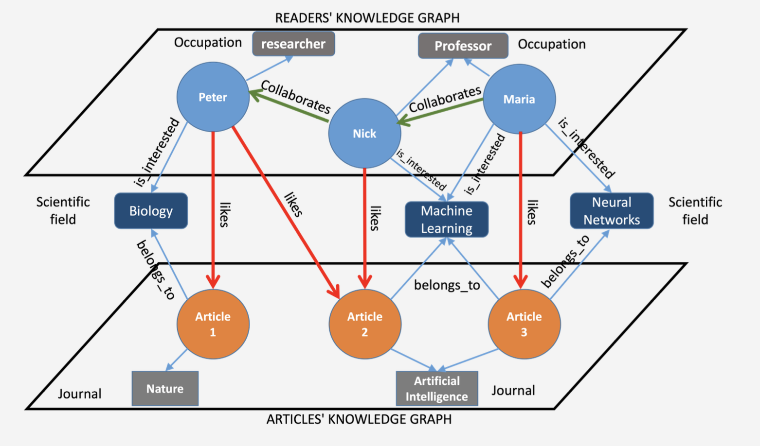
Example (2/9)
Constructing a user-article bipartite graph
Key reader characteristics: profession and research interests.
Red directed edges: Research article liking by a reader.
Green edges: Capturing reader interactions with other readers.
Caution! The blue edges refer to the characteristics (properties) of a node

Slide 47
Example (3/9):
Requested: Predict the interests of Peter the reader (e.g. Articles he likes)
Solution:
Formation of a new graph.
Peter at the center of concentric circles (convolutional layers) of a neural network.
Heterogeneous Graph →Two types of nodes (readers and articles).

Slide 48
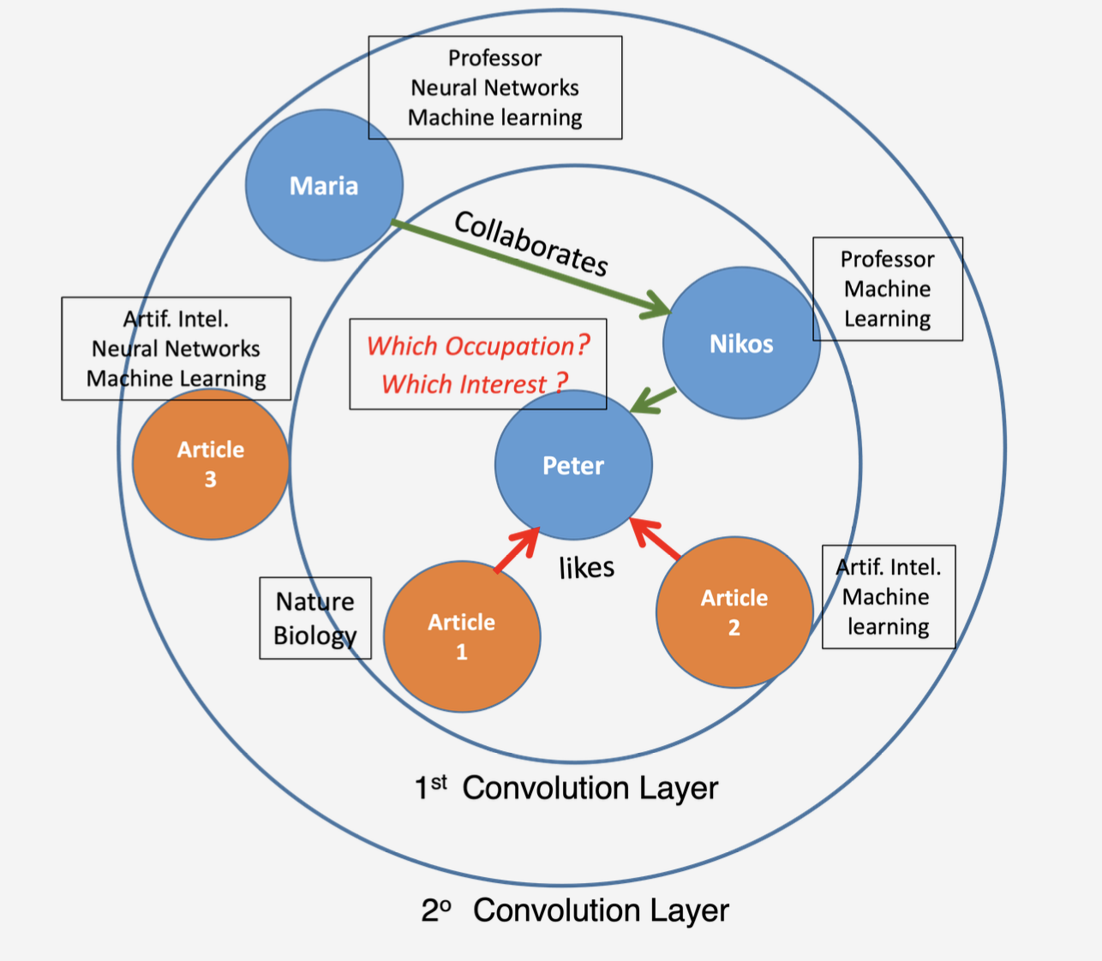
Example (4/9)
Concentric GCN Convolutional Layers to create a latent “Peter” node representation for the Example data.
2ᵒ Στρώμα Συνέλιξης

Slide 49
Example (5/9):
Basic functionality of Graph Convolutional Network (GCN):
Aggregation of information from neighboring nodes of the node under consideration
Forward information to the next convolutional layer.
Reader Latent Vector Prediction “Peter”.
Layer-by-layer propagation and aggregation of the features of Peter's neighboring nodes to represent his preferences.
Types of edge:
Collaborations (edges in green).
Preferences (likes) for articles (edges in red).

Slide 50
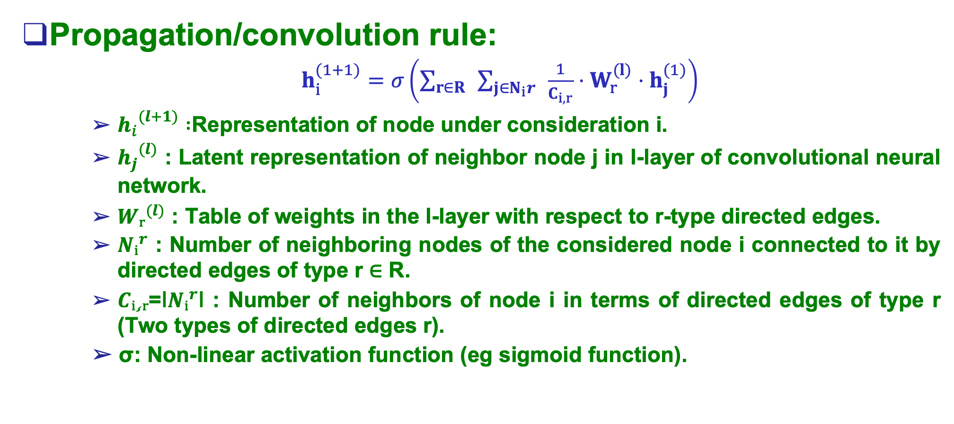
Example (6/9):
Propagation/convolution rule:
$h_{i}^{(1+1)}=σ\left(\sum_{r∈R}{ }\sum_{j∈N_{i}r}{ }\frac{1}{C_{i,r}}⋅W_{r}^{(l)}⋅h_{j}^{(1)}\right)$
${h_{i}}^{(l+1)} :$Representation of node under consideration i.
${h_{j}}^{(l)}$ : Latent representation of neighbor node j in l-layer of convolutional neural network.
${Wᵣ}^{(l)}$ : Table of weights in the l-layer with respect to r-type directed edges.
${Nᵢ}^{r}$ : Number of neighboring nodes of the considered node i connected to it by directed edges of type r ∈ R.
$Cᵢ¸ᵣ$=ǀ${Nᵢ}^{r}$ǀ : Number of neighbors of node i in terms of directed edges of type r (Two types of directed edges r).
σ: Non-linear activation function (eg sigmoid function).

Slide 51
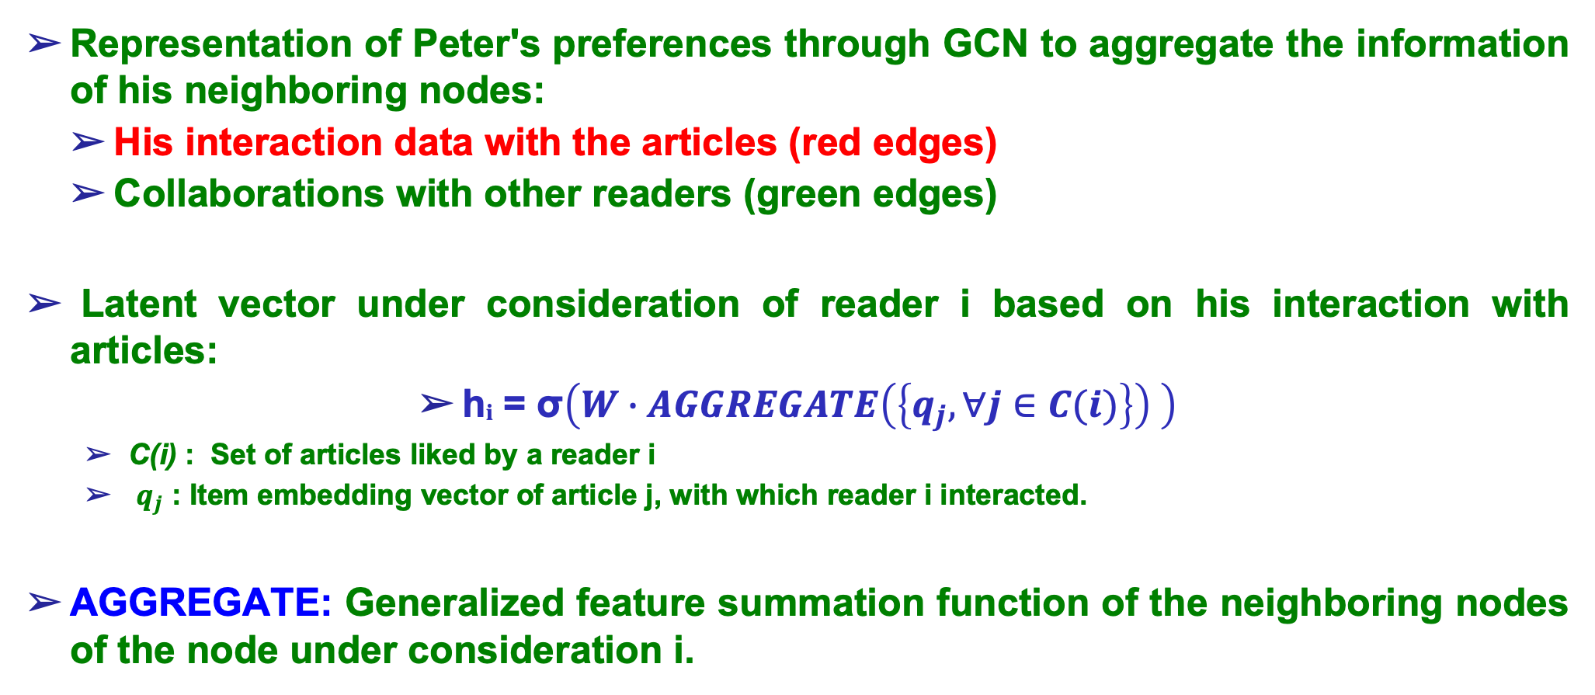
Example (7/9):
Representation of Peter's preferences through GCN to aggregate the information of his neighboring nodes:
His interaction data with the articles (red edges)
Collaborations with other readers (green edges)
Latent vector under consideration of reader i based on his interaction with articles:
hᵢ = σ$\left(W∙AGGREGATE\left(\left\{q_{j},∀j∈C(i)\right\}\right) \right)$
C(i) : Set of articles liked by a reader i
$q_{j}$ : Item embedding vector of article j, with which reader i interacted.
AGGREGATE: Generalized feature summation function of the neighboring nodes of the node under consideration i.

Slide 52
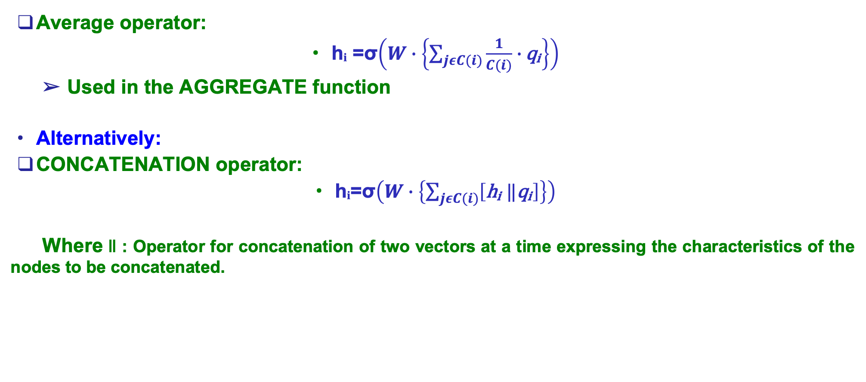
Example (8/9):
Average operator:
hᵢ =σ$\left(W∙\left\{\sum_{jεC(i)}{\frac{1}{C(i)}∙}\text{q}\text{ᵢ}\right\}\right)$
Used in the AGGREGATE function
Alternatively:
CONCATENATION operator:
hᵢ=σ$\left(W∙\left\{\sum_{jεC(i)}{\left[\text{h}\text{ᵢ} ‖\text{q}\text{ᵢ}\right]}\right\}\right)$
Where ‖ : Operator for concatenation of two vectors at a time expressing the characteristics of the nodes to be concatenated.

Slide 53
Example (9/9):
Final Predictions:
Through the nodes Article 1 and Article 2
Peters’s Topic of Interest (Biology or Machine Learning)
Through Maria’s and Nick’s nodes
Peter’s Profession
(University professor)

Slide 54
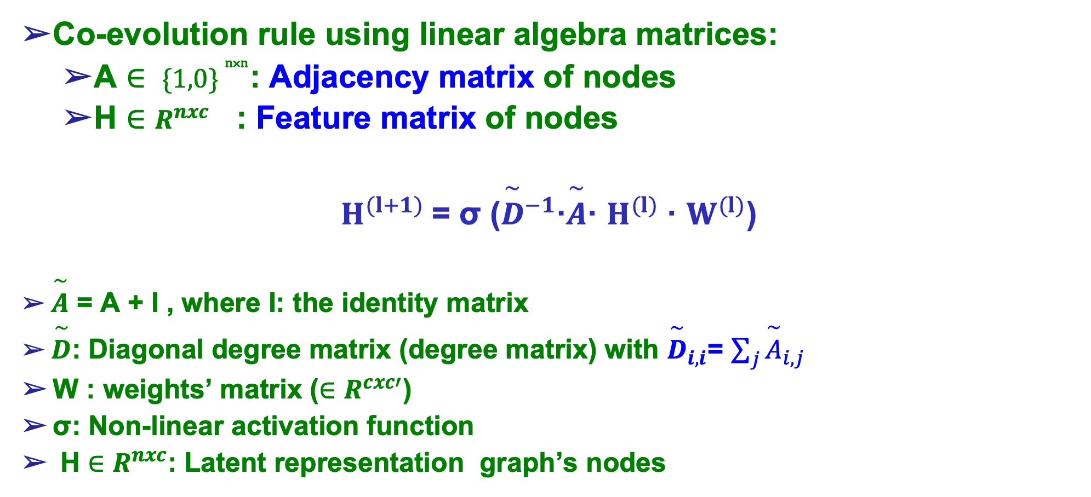
Node Representation via GCN using matrixes (1/3):
Co-evolution rule using linear algebra matrices:
A $∈ \{1,0\} ^{ⁿ˟ⁿ}$: Adjacency matrix of nodes
H $∈$ $R^{nxc}$ : Feature matrix of nodes
$Η^{(l+1)}$= σ (${\overset{\sim }{D}}^{−1}$∙$\overset{\sim }{A}$· $Η^{(l)}$· $W^{(l)}$)
$\overset{\sim }{A}$ = A + I , where I: the identity matrix
$\overset{\sim }{D}$: Diagonal degree matrix (degree matrix) with ${\overset{\sim }{D}}_{i,i}$= $\sum_{j}{{\overset{\sim }{A}}_{i,j}}$
W : weights’ matrix ($∈$ $R^{cxc′}$)
σ: Non-linear activation function
H $∈$ $R^{nxc}$: Latent representation graph’s nodes

Slide 55
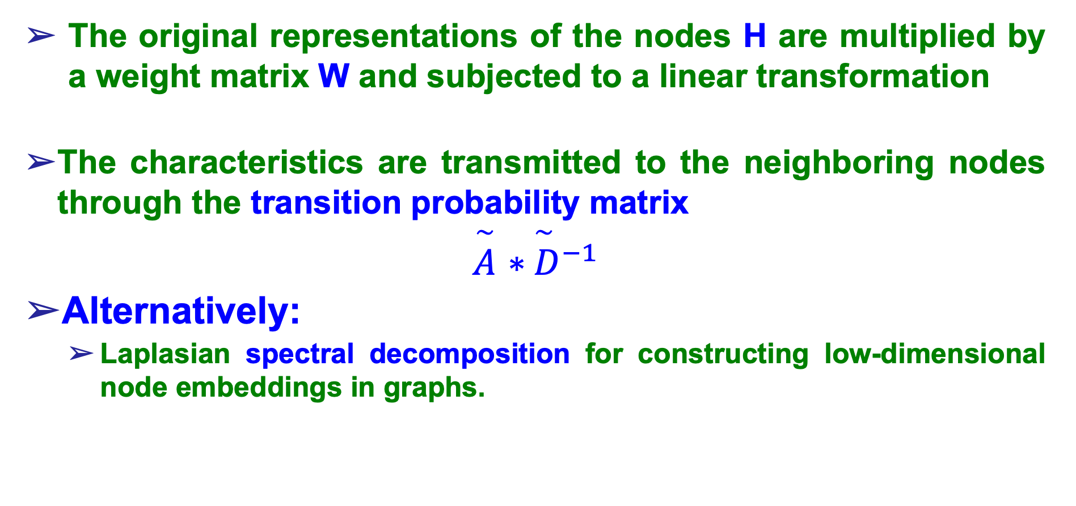
Node Representation via GCN using Tables (2/3):
The original representations of the nodes H are multiplied by a weight matrix W and subjected to a linear transformation
The characteristics are transmitted to the neighboring nodes through the transition probability matrix
$\overset{\sim }{A}$ ${∗\overset{\sim }{ D}}^{−1}$
Alternatively:
Laplasian spectral decomposition for constructing low-dimensional node embeddings in graphs.

Slide 56
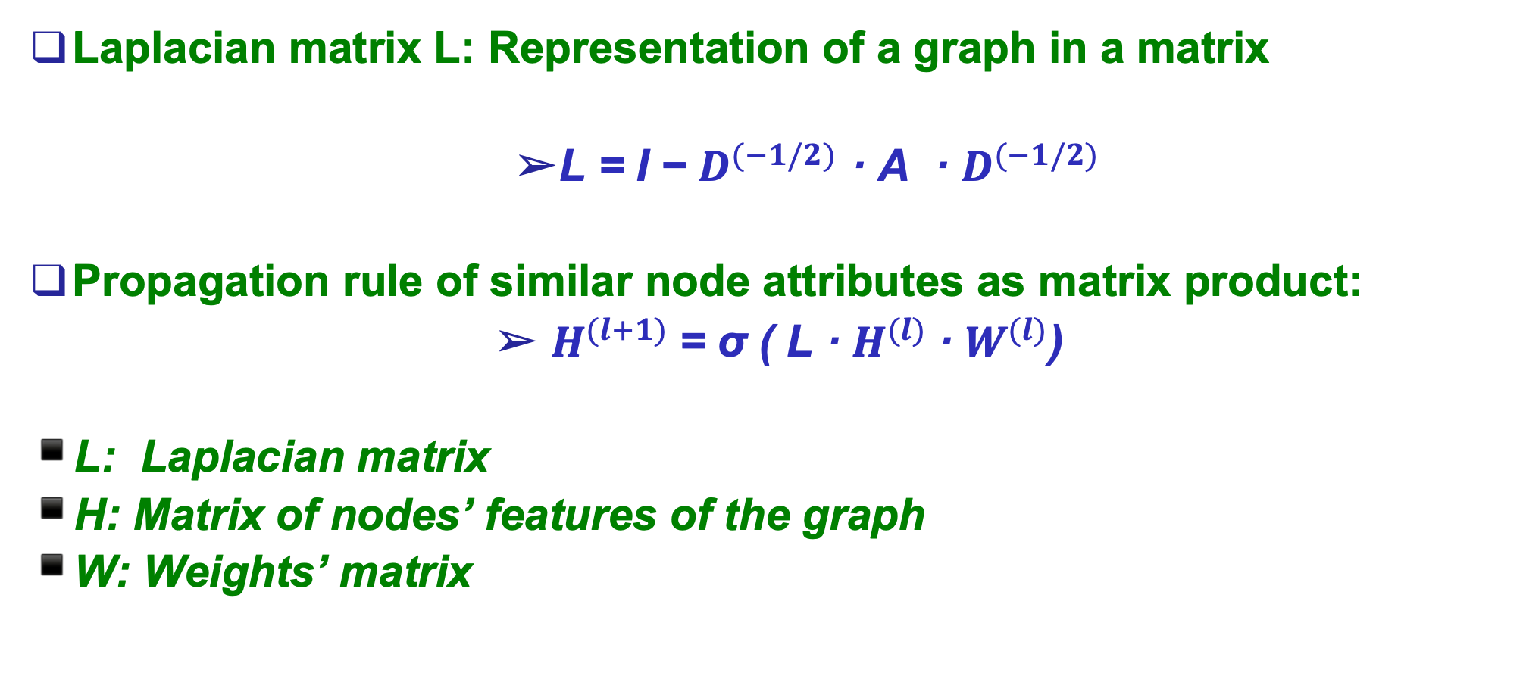
Node Representation via GCN using Tables (3/3):
Laplacian matrix L: Representation of a graph in a matrix
L = I − $D^{(−1/2)}$ · A · $D^{(−1/2)}$
Propagation rule of similar node attributes as matrix product:
$Η^{(l+1)}$= σ ( L · $H^{(l)}$· $W^{(l)}$)
L: Laplacian matrix
H: Matrix of nodes’ features of the graph
W: Weights’ matrix

Slide 57
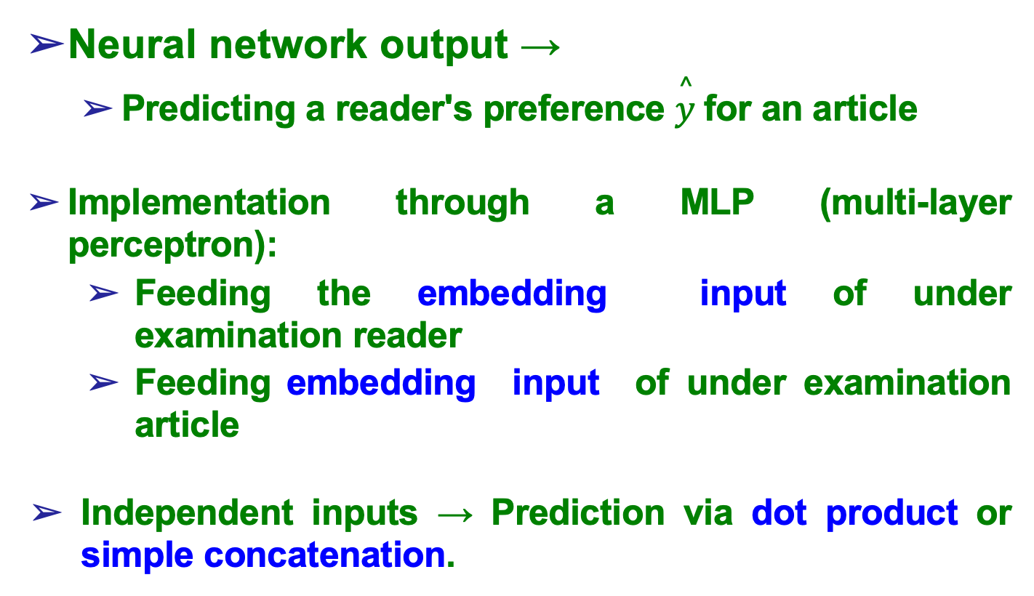
Defining an Objective Function for Predicting Scores (1/3):
Neural network output →
Predicting a reader's preference $\overset{^}{y}$ for an article
Implementation through a MLP (multi-layer perceptron):
Feeding the embedding input of under examination reader
Feeding embedding input of under examination article
Independent inputs → Prediction via dot product or simple concatenation.

Slide 58
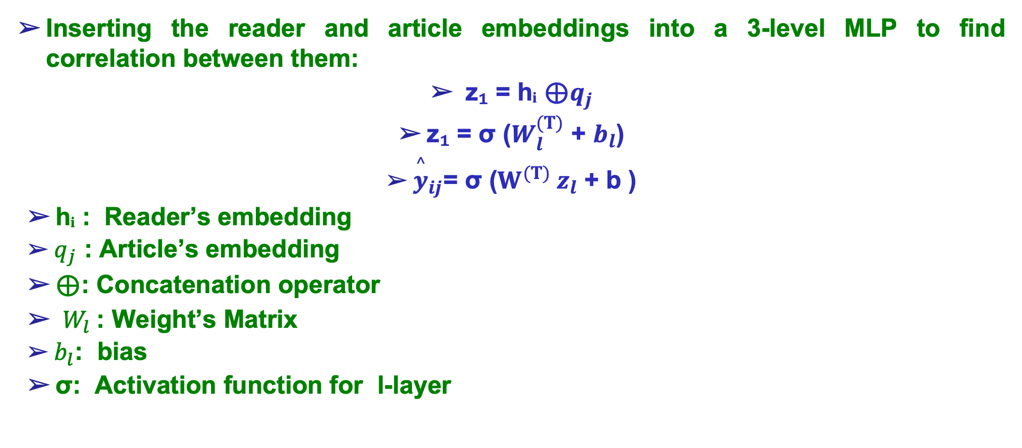
Defining an Objective Function for Predicting Scores (2/3):
Inserting the reader and article embeddings into a 3-level MLP to find correlation between them:
z₁ = hᵢ ⊕$q_{j}$
z₁ = σ ($W_{l}^{(T)}$ + $b_{l}$)
${\overset{^}{y}}_{ij}$= σ ($W^{(T)} z_{l}$ + b )
hᵢ : Reader’s embedding
$q_{j}$ : Article’s embedding
⊕: Concatenation operator
$W_{l}$: Weight’s Matrix
$b_{l}$: bias
σ: Activation function for l-layer

Slide 59
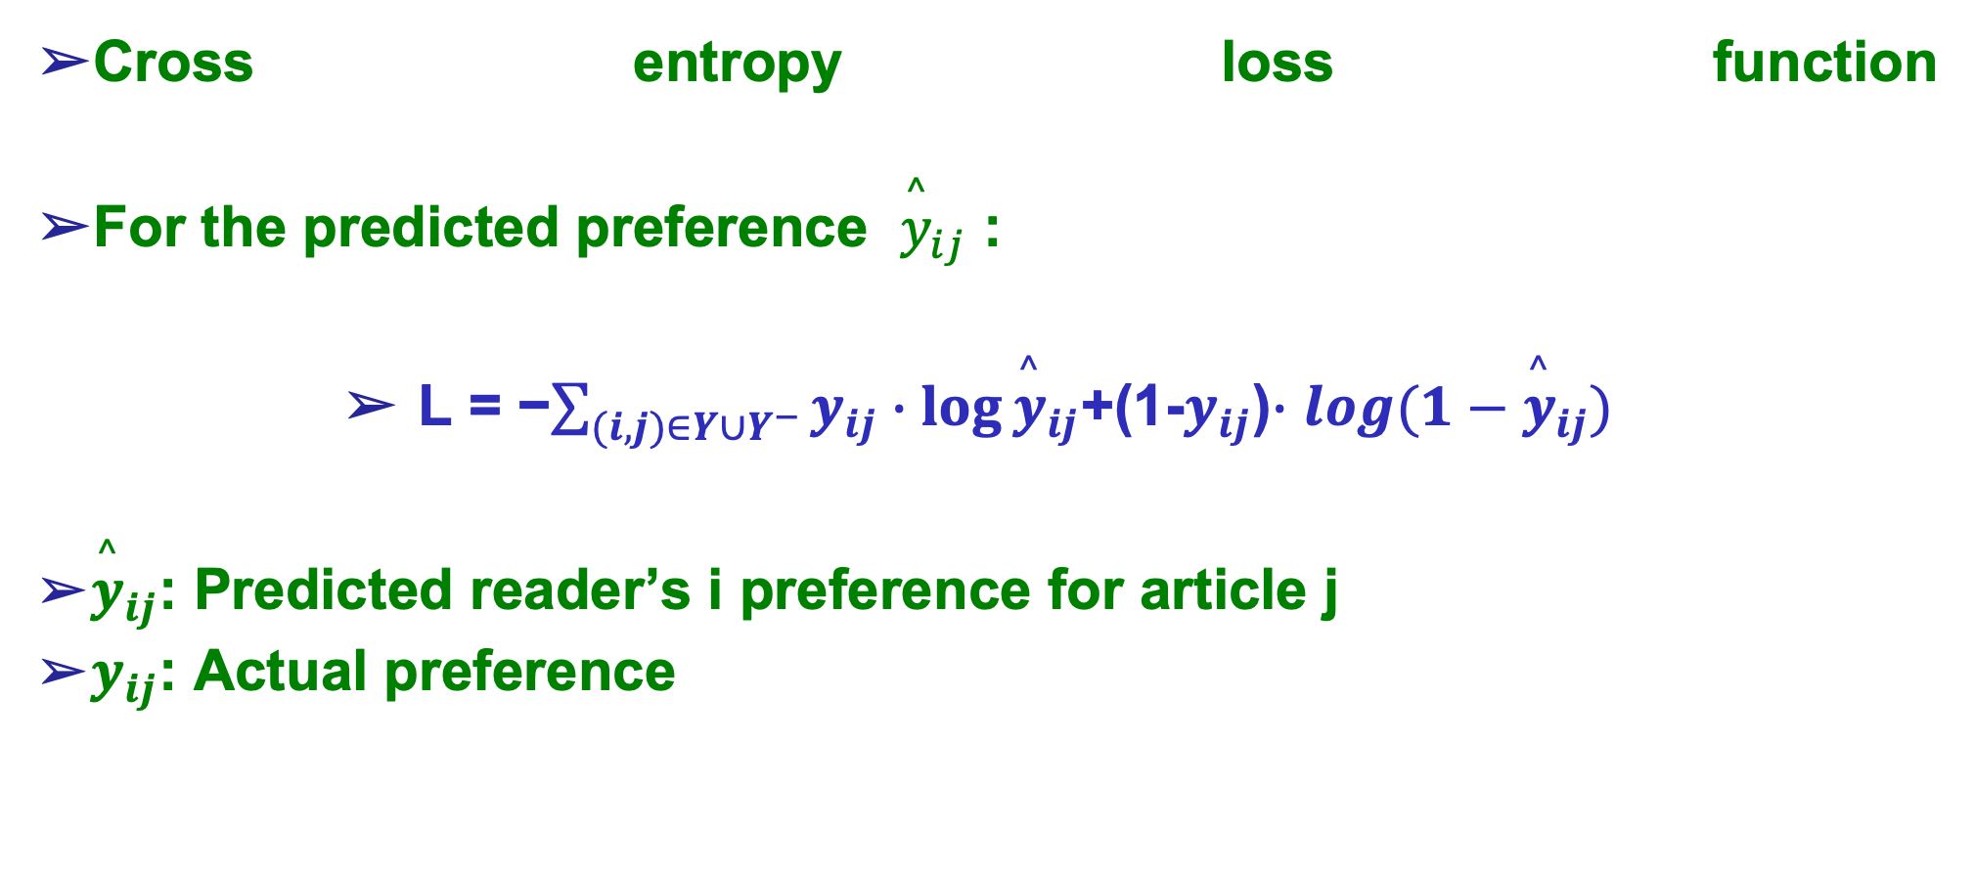
Defining an Objective Function for Predicting Scores (3/3):
Cross entropy loss function
For the predicted preference ${\overset{^}{y}}_{ij}$ :
L = −$\sum_{(i,j)∈Y∪Y^{−}}{y_{ij}∙\log{{\overset{^}{y}}_{ij}}}$+(1-$y_{ij}$)$∙$ $\log{(1−{\overset{^}{y}}_{ij})}$
${\overset{^}{y}}_{ij}$: Predicted reader’s i preference for article j
$y_{ij}$: Actual preference

Slide 60
Graph Embeddings (1/2):
Methods for dimensionality reduction of graph node features
More effective graph data analytics.
Use:
Similarity inference
Link prediction between users - bipartite graph’s elements.

Slide 61
Graph Embeddings (2/2):
Algorithms Node2vec και DeepWalk (Leskovec et al., 2016):
Vector representations of a node → Identifying semantically "similar" nodes.
Graph Traversal with Random Walks (random walks).
Skip – gram model →Latent representations of graph nodes.
Algorithm Metapath2vec (Dong et al. , 2017):
Expand of node2vec and DeepWalk.
Application to heterogeneous graphs using meta-path based random walks.

Slide 62
Chapter’s Questions
List some basic activation functions that cannot be used in a neural network. What is the difference between linear and nonlinear activation functions?
What are the basic layers of a co-evolutionary neural network (CNN)? Describe the function of each separately.
Describe the basic function performed by a GCN (Graph Convolutional Network) type neural network?

Slide 63
Recommender Systems with Python
Chapter 6^{ο} :
Machine Learning with Neural Networks

